Slide 1
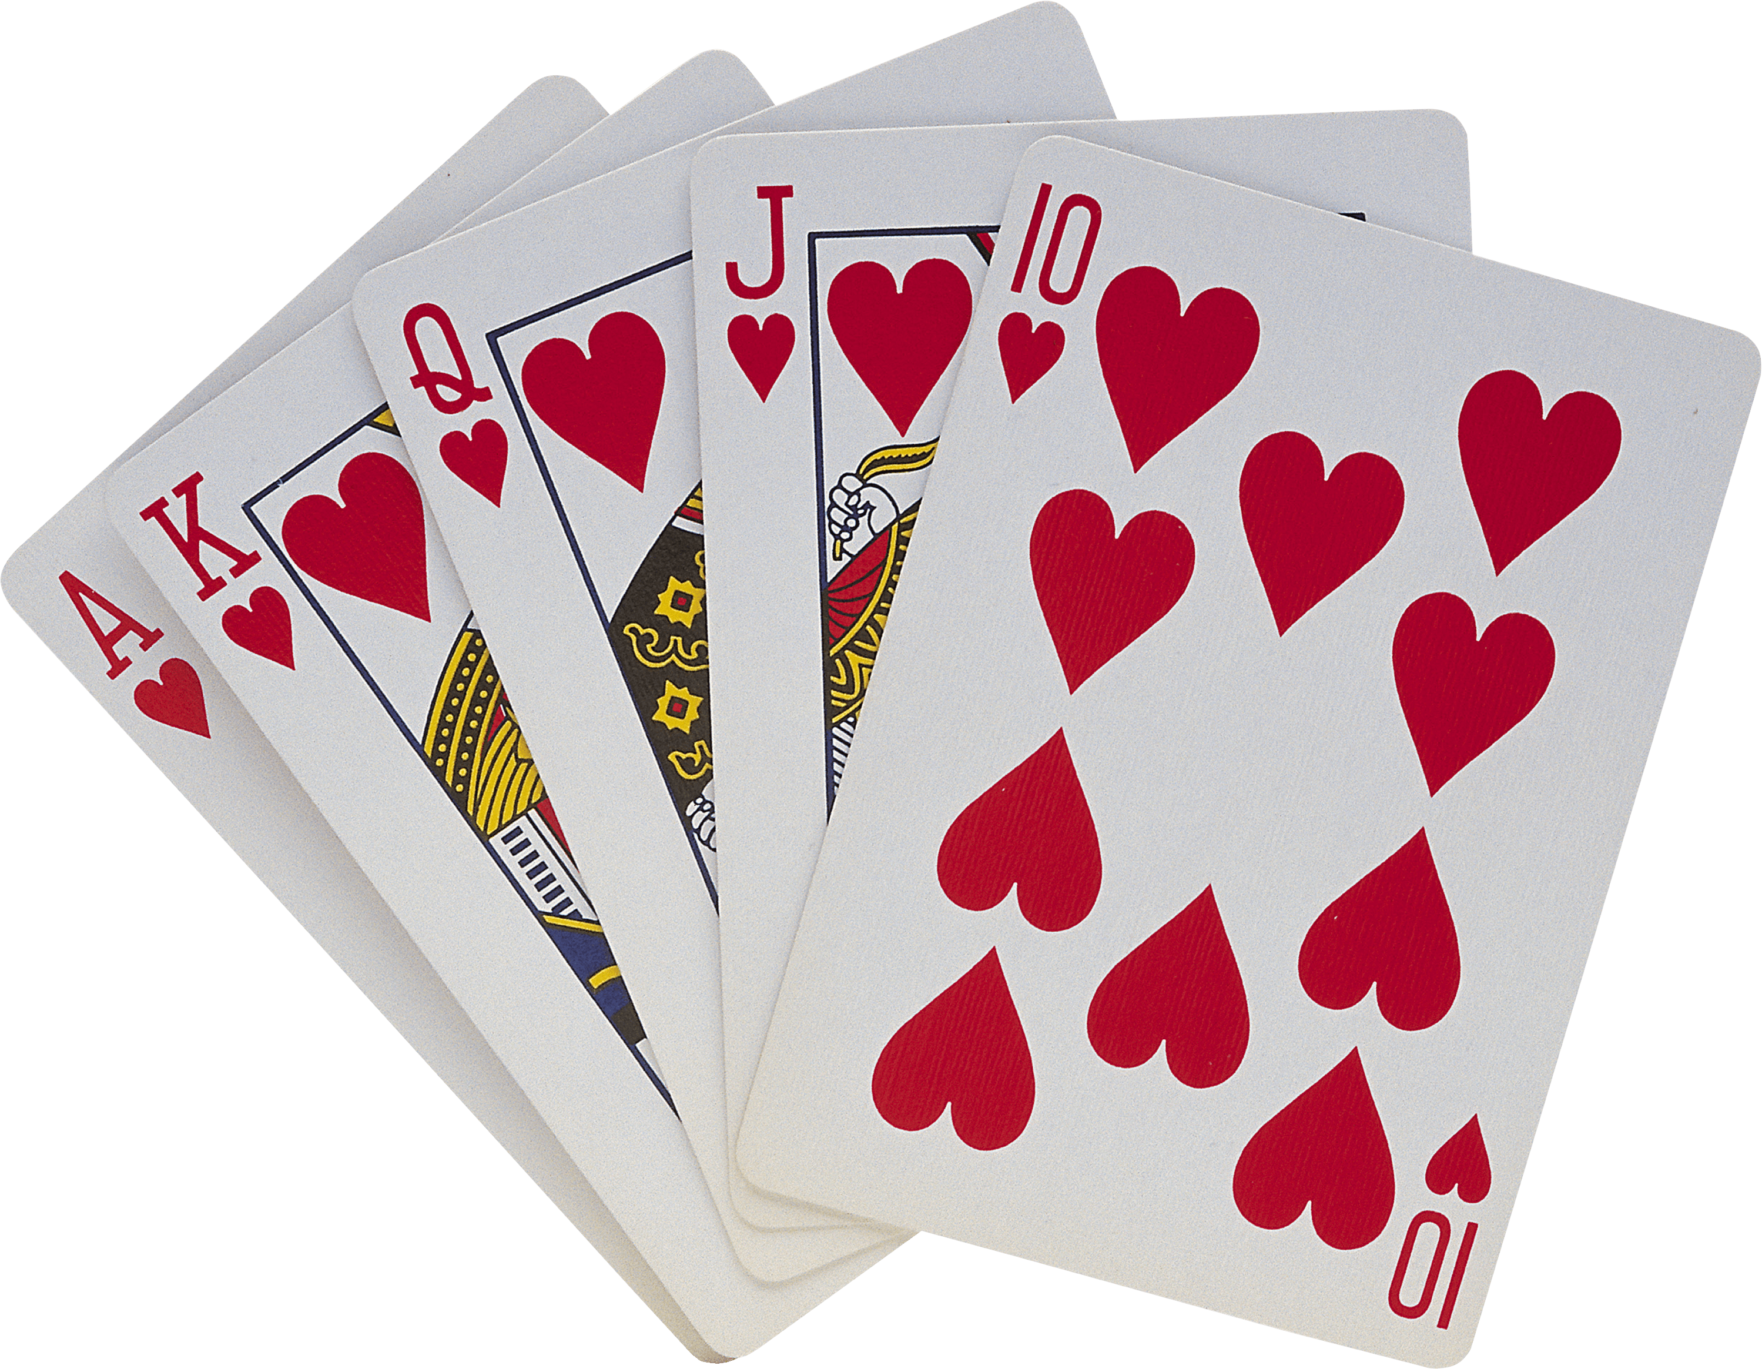

Kotshena Team https://github.com/AmirAhmedECEGit/Kotshena.git
Embedded Systems Data Structures
Amir Ahmed Hassan
Ahmed Sayed Bakry
Omnia Ehab

Slide 2
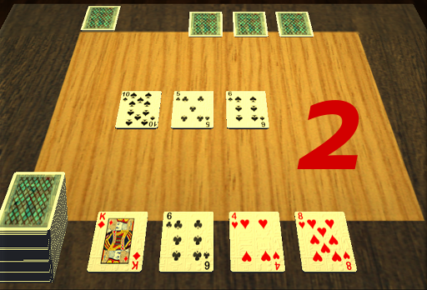
Egyptian Komey/Basra game Desription/Rules:
the deck consists of 52 playing cards:
Numbers (1 -> 10) and Pictures (J,Q,K)
You can eat/bank floor cards that sum up to your card

Slide 3
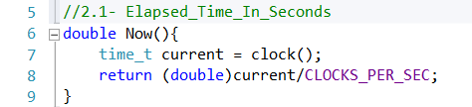
CODE Flow:
1- Macros
2- Utility functions
3- Data Structures (AVL TREE – HASH TABLE)
4- Gamified Structures
Player Hand -> AVL : stores player cards hierarchically, it also compares ranks.
Floor and Deck -> Hash Table : stores cards indexed with hashing function.
5- Komey Class
Play() function which codes for Rounds and Scores

Slide 4
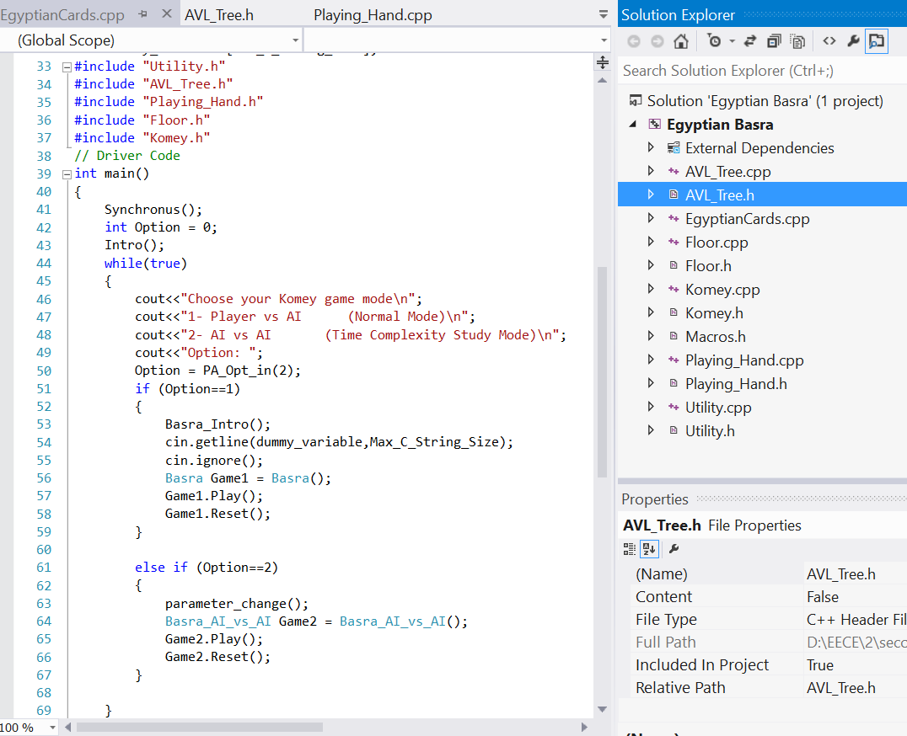
Headers & OOP
Organize code
Reduced main file size from 1400 lines to 70 lines!
Helped with debugging

Slide 5
Time Complexity
Hash Table :
O(1): insertion and deletion
O(1): searching a card in it
O(1): deleting multiple cards in same round
AVL Tree:
O(Log n): insertion and deletion
Rank Tree:
O(n): comparison of card ranks for AI to play best possible win

Slide 6
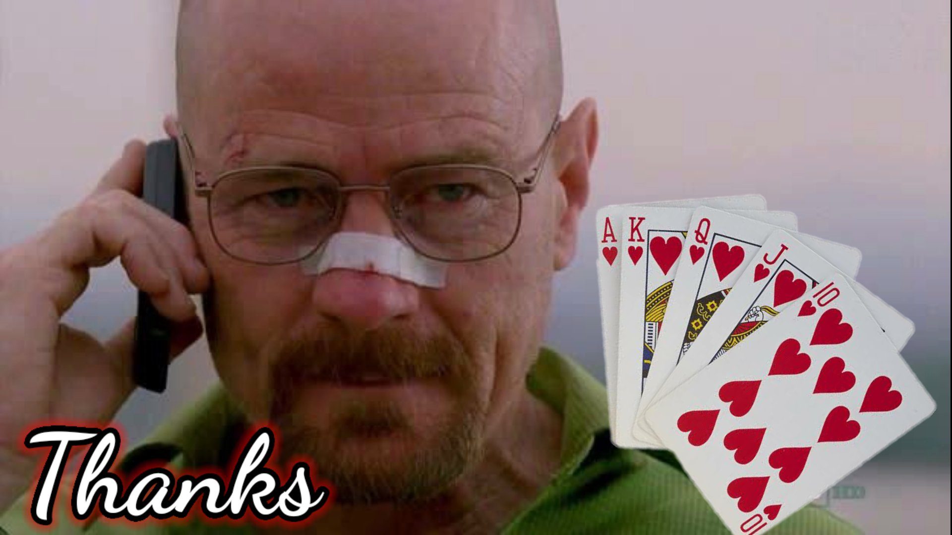
Any Questions?

